Slide 1
Basic Statistics (2016)
Total Population (1,000 persons) | 23,540
Population Density (Persons/Km²) | 650
Population aged under 15 (%) | 13.3
Population aged over 64 (%) | 13.2
Crude Birth Rate (‰) | 8.9
Crude Death Rate (‰) | 7.3
Total Fertility Rate (Per woman) | 1.2
International Comparisons
 | Life Expectancy at Birth | Healthy Life Expectancy at Birth | Neonatal Mortality Rate | Maternal Mortality Ratio | Current Health Expenditure
 |  |  |  |  | As a share of GDP | Per Capita
Country | (Years) 2015 |  | (Per 1,000 live births) | (Per 100,000 live births) | (%) 2014 | (US$ PPP) 2014
 |  |  | 2015
Taiwan | 80.2 | 71.2 | 2.5 | 12 | 5.9 | 2,732
Australia | 82.8 | 71.9 | 2.2 | 6 | 9.1 | 4,289
Canada | 82.2 | 72.3 | 3.2 | 7 | 10.0 | 4,502
France | 82.4 | 72.6 | 2.2 | 8 | 11.1 | 4,464
Germany | 81.0 | 71.3 | 2.1 | 6 | 11.1 | 5,200
Japan | 83.7 | 74.9 | 0.9 | 5 | 10.8 | 4,269
UK | 81.2 | 71.4 | 2.4 | 9 | 9.8 | 3,989
US | 79.3 | 69.1 | 3.6 | 14 | 16.5 | 9,036

Slide 2
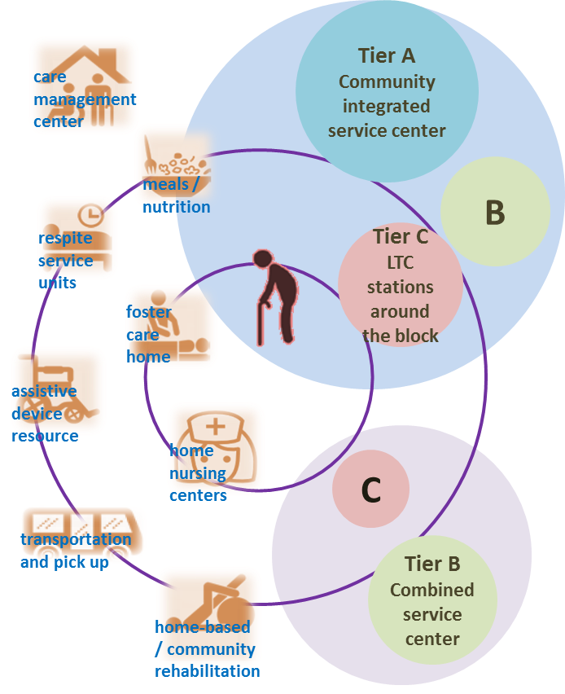
Responding to an Aging Society
The Long-term Care 2.0 program is designed to create a comprehensive care system that integrates medical care, long-term care services, housing, preventative care, and social assistance, allowing people with disabilities to receive the care they need within a 30-minute drive.
Taiwan’s Universal Health Coverage
Since its launch in 1995, Taiwan’s National Health Insurance program has successfully provided universal, high-quality health care at an affordable cost.
Universal | 99.9% coverage rate
Comprehensive | NHI covers all medically necessary services, the provision of over 16,000 prescription drugs, and home and rehabilitative care.
Accessible | Per 10,000 persons (2016): Density of health workforce: 122.8 persons Beds available at health facilities: 69.3
Affordable | Total health expenditure (2016): As a share of GDP: 6.3% Per capita: US$1,430

Slide 3
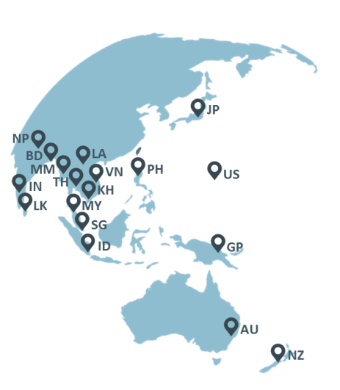
Communicable Disease Prevention and Control
Taiwan was among the first eight countries to employ the WHO’s IHR 2005: Joint External Evaluation (JEE) tool, demonstrating our public health capacity and setting an example for the Asia-Pacific region. To strengthen the Asia-Pacific region’s capacity to diagnose, prevent, and respond to Ebola, MERS, dengue fever, Zika, and Chikungunya, Taiwan and the US jointly organized several training workshops for participants from across the region. Taiwan has successfully eradicated several deadly diseases, including malaria (1965) and polio (2000). A national immunization program (NIP), begun in 1954, has also reduced the incidence of other communicable diseases.

Slide 5
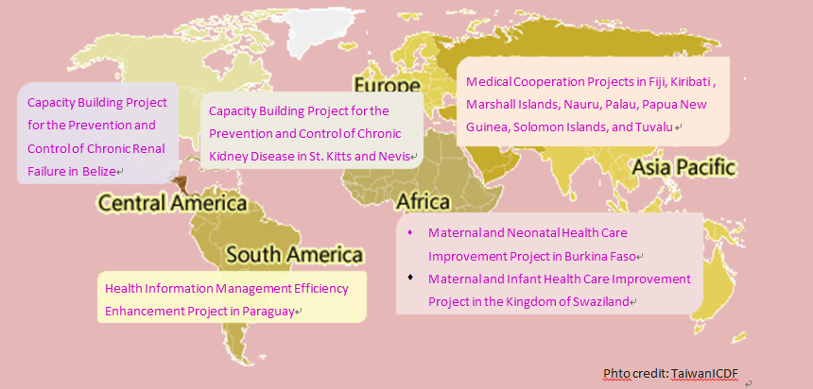
Medical Cooperation Projects in Fiji, Kiribati , Marshall Islands, Nauru, Palau, Papua New Guinea, Solomon Islands, and Tuvalu
Medical Cooperation Projects in Fiji, Kiribati , Marshall Islands, Nauru, Palau, Papua New Guinea, Solomon Islands, and Tuvalu
Capacity Building Project for the Prevention and Control of Chronic Renal Failure in Belize
Capacity Building Project for the Prevention and Control of Chronic Renal Failure in Belize
Capacity Building Project for the Prevention and Control of Chronic Kidney Disease in St. Kitts and Nevis
Capacity Building Project for the Prevention and Control of Chronic Kidney Disease in St. Kitts and Nevis
Maternal and Neonatal Health Care Improvement Project in Burkina Faso
Maternal and Infant Health Care Improvement Project in the Kingdom of Swaziland
Maternal and Neonatal Health Care Improvement Project in Burkina Faso
Maternal and Infant Health Care Improvement Project in the Kingdom of Swaziland
Health Information Management Efficiency Enhancement Project in Paraguay
Health Information Management Efficiency Enhancement Project in Paraguay

